Slide 1
Intro to Natural Language Processing Project Delivery #4 - Named Entity Recognition
150118825 Ahmet Hakan Ekşİ
150117051 Metehan Ertan
150115025 Mert İsmail Eğİ

Slide 2
Preprocessing
We directly read data.
Then we split tags and text into single word by whitespace.
Then we check number of tags and number of words for each sentence.
There is some inconsistent entries not because of the dataset, but because of read_csv function.
We remove inconsistent entries.
And then we split our dataset into training and testing part with ratio 0.8, 0.2.

Slide 3
Model
We tried to use BiLSTM-CRF with Tensorflow-Keras but we can’t successfully build structure.
Then we decided to use cased base BERT model (BERTurk)[1] pre-trained on a Turkish corpus of size 35GB and 44,04,976,662 tokens.[2]
And we used it with NERDA[3] to build our model. It uses PyTorch. We can’t use this model with any other hyperparameter due to performance constraints. Only 1 epoch, takes about 2 hour with Google Colab GPU, and we can’t use Colab GPU often due to limitations.
We train it with our training part and testing with testing part.
And also, we save our model therefore, we can demo whenever we want.
[1] https://huggingface.co/dbmdz/bert-base-turkish-cased
[2] https://medium.com/analytics-vidhya/named-entity-recognition-for-turkish-with-bert-f8ec04a31b0
[3] https://towardsdatascience.com/easy-fine-tuning-of-transformers-for-named-entity-recognition-d72f2b5340e3

Slide 4
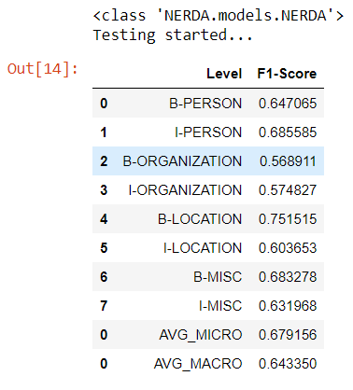
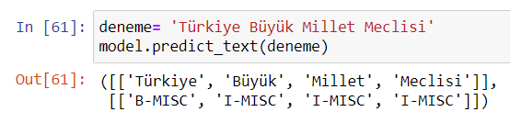
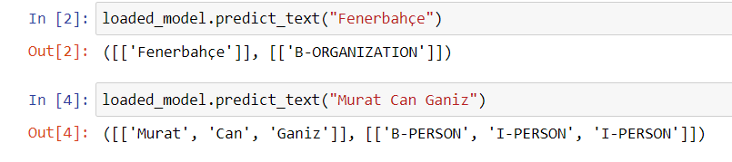
Results

Slide 5
Conclusion
On our observations, our model successfully predict short sequences/sentences. But in long sentences even if we used predicted short sequences like “Türkiye Büyük Millet Meclisi”, our model can’t predict it same way it in long sentences. Therefore, maybe we use our model predict NERs in TBMM corpus by smaller pieces.
We didn’t use model on whole TBMM corpus yet.
We don’t have any optimization yet; we are thinking to use extracted “milletvekili” names directly as NER and also cities.
We don’t have BiLSTM-CRF model yet. We will continue to trying to build that model. We are planning fastTexts Turkish pre-trained vectors as word embedding in BiLSTM-CRF.
**All the references cited in code…

